Slide 1
Chapter 1
Getting Started

Slide 2
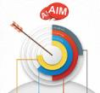
Goals
1. Learn about the advantages of Python
2. Set up the programming environment for your computers
3. Learn to write the first program in Python

Slide 3
Why Python?
Easy to write, easy to read, and easy to extend and build upon.
Versatile for many fields: science, business, web and etc..
Open sources: well-connected and supportive community.

Slide 4
Setting up the programming environment
Windows
Linux（Ubuntu）
Mac OS

Slide 5
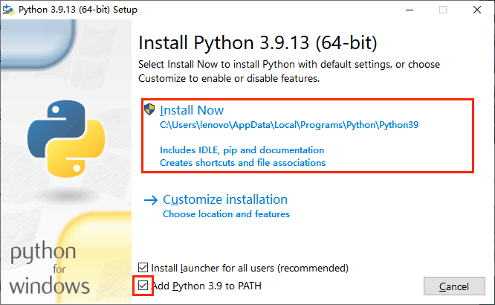
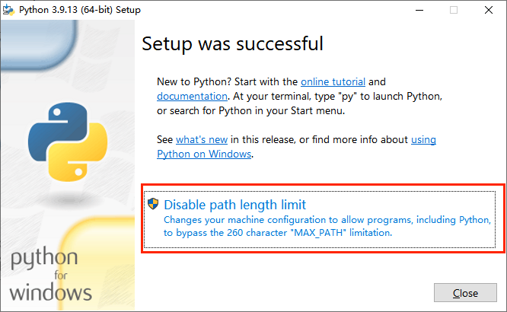
Windows

Slide 6
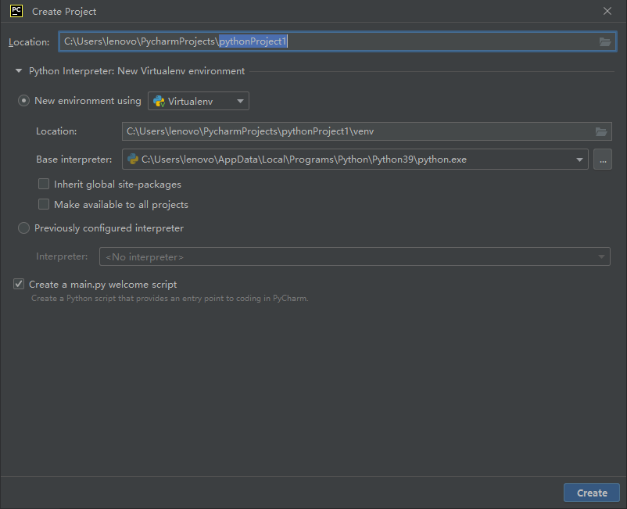
Windows

Slide 7
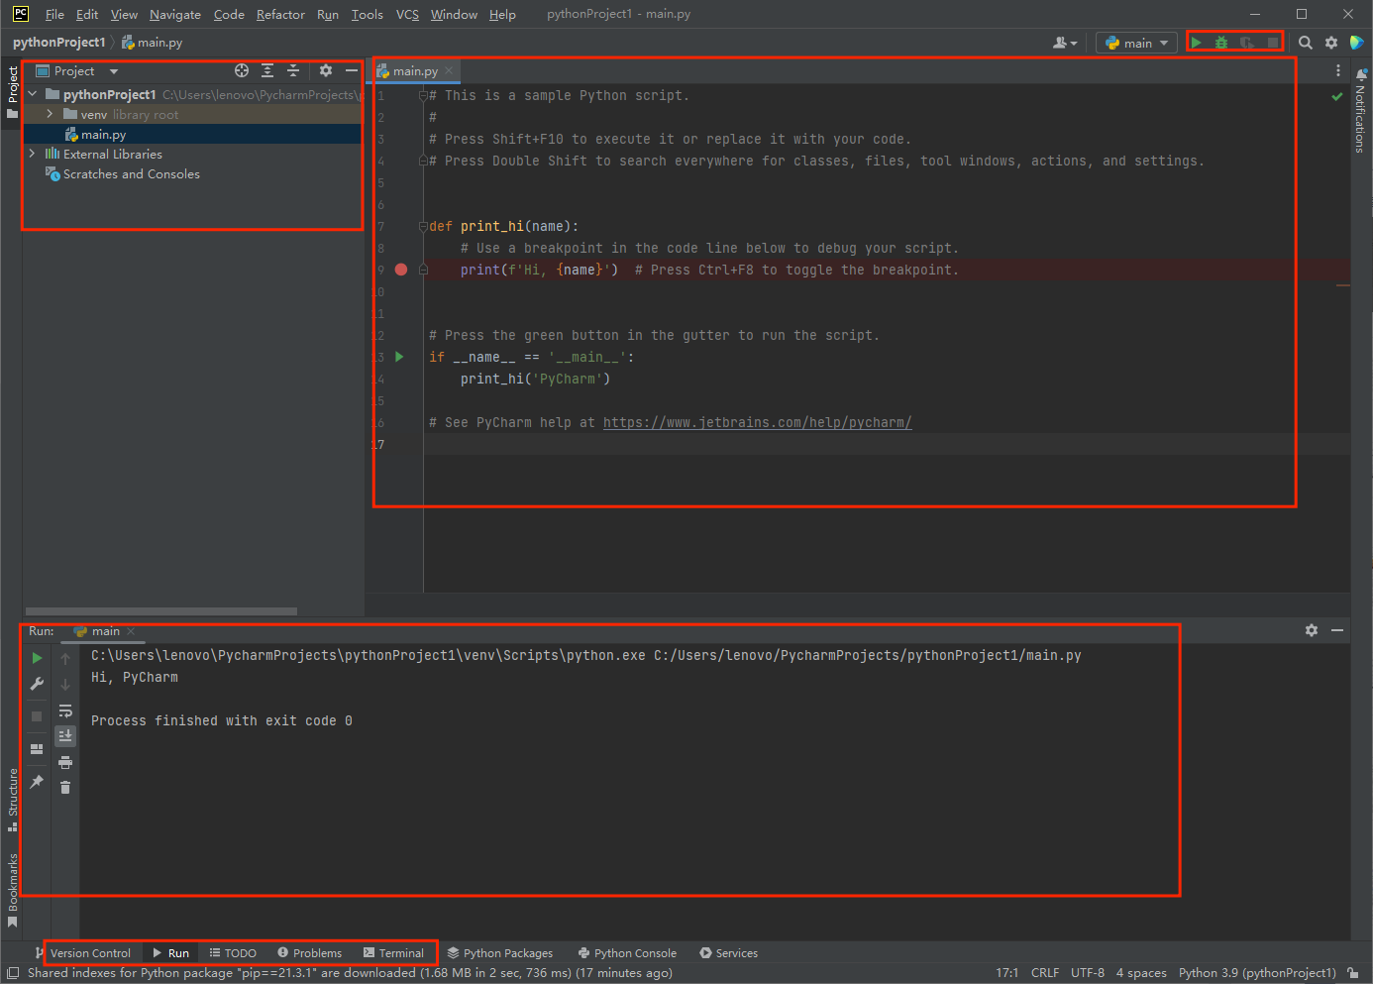
Windows

Slide 8
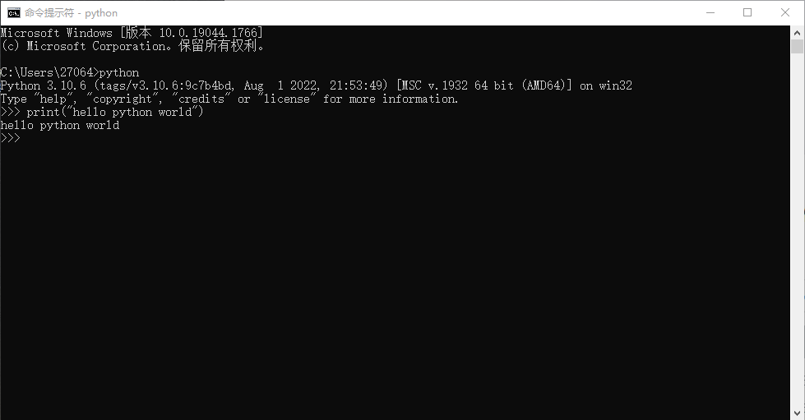
Windows

Slide 9
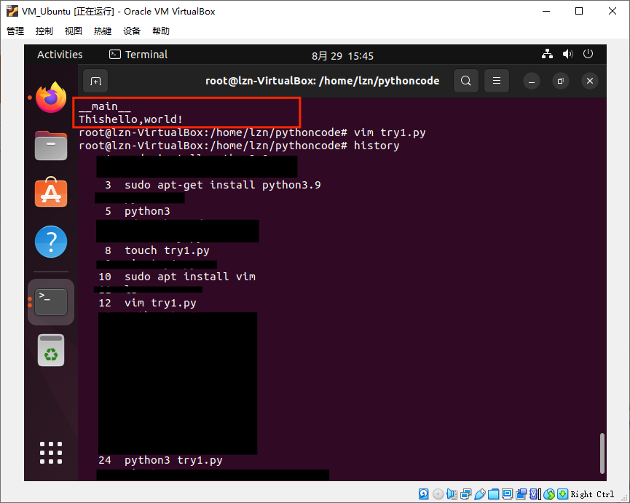
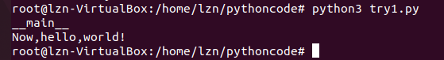
Linux

Slide 10
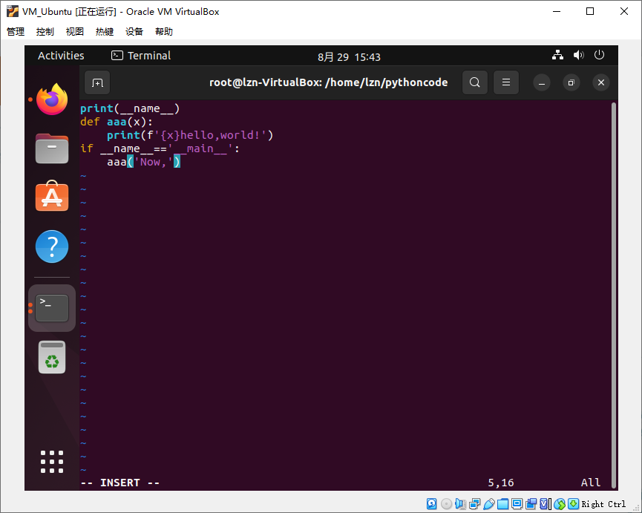
Linux

Slide 11
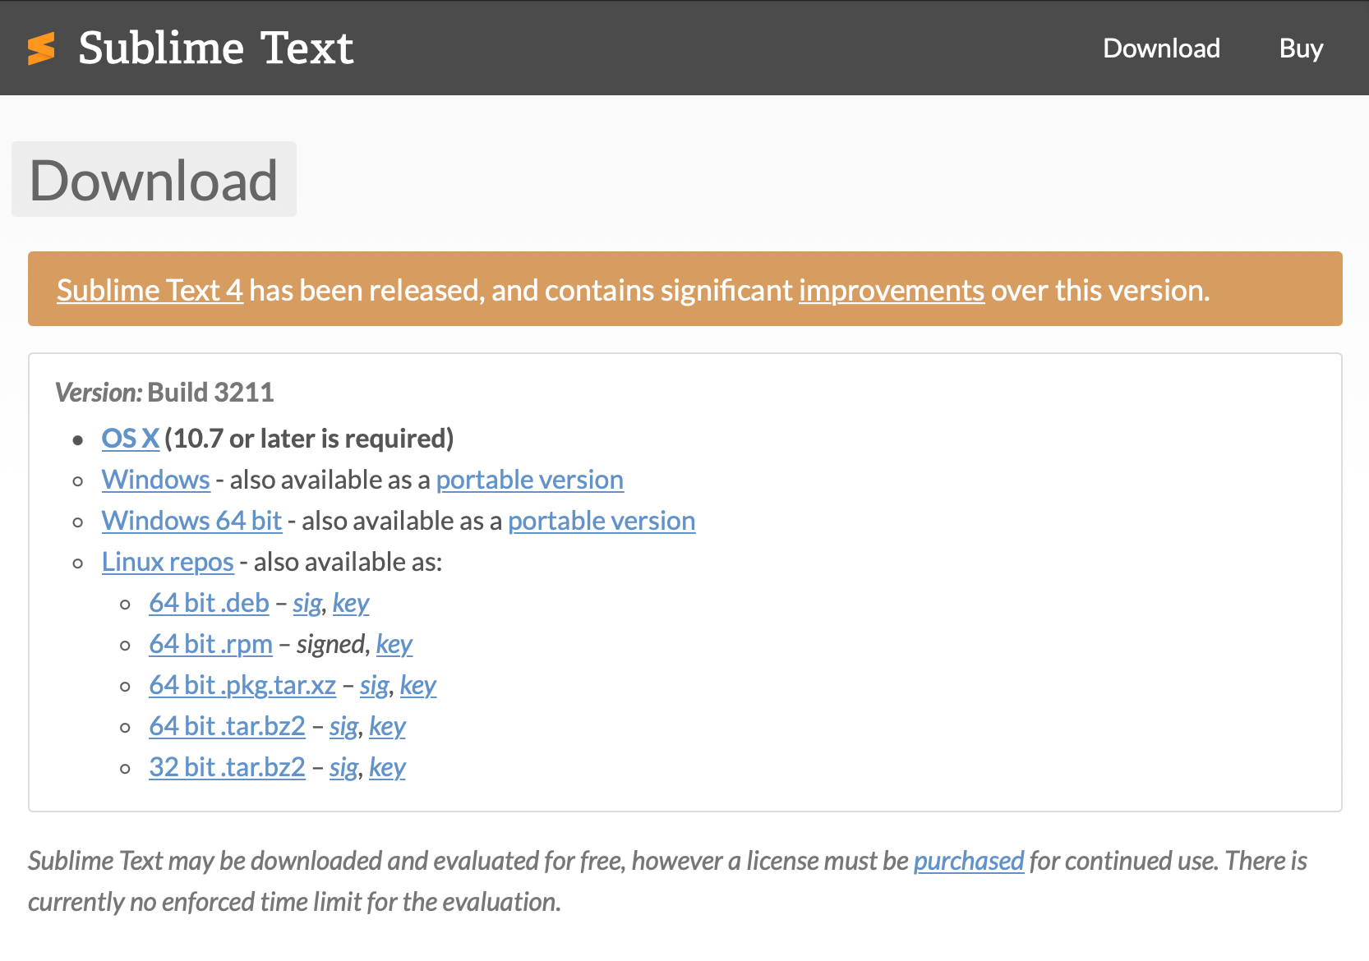
Mac

Slide 12
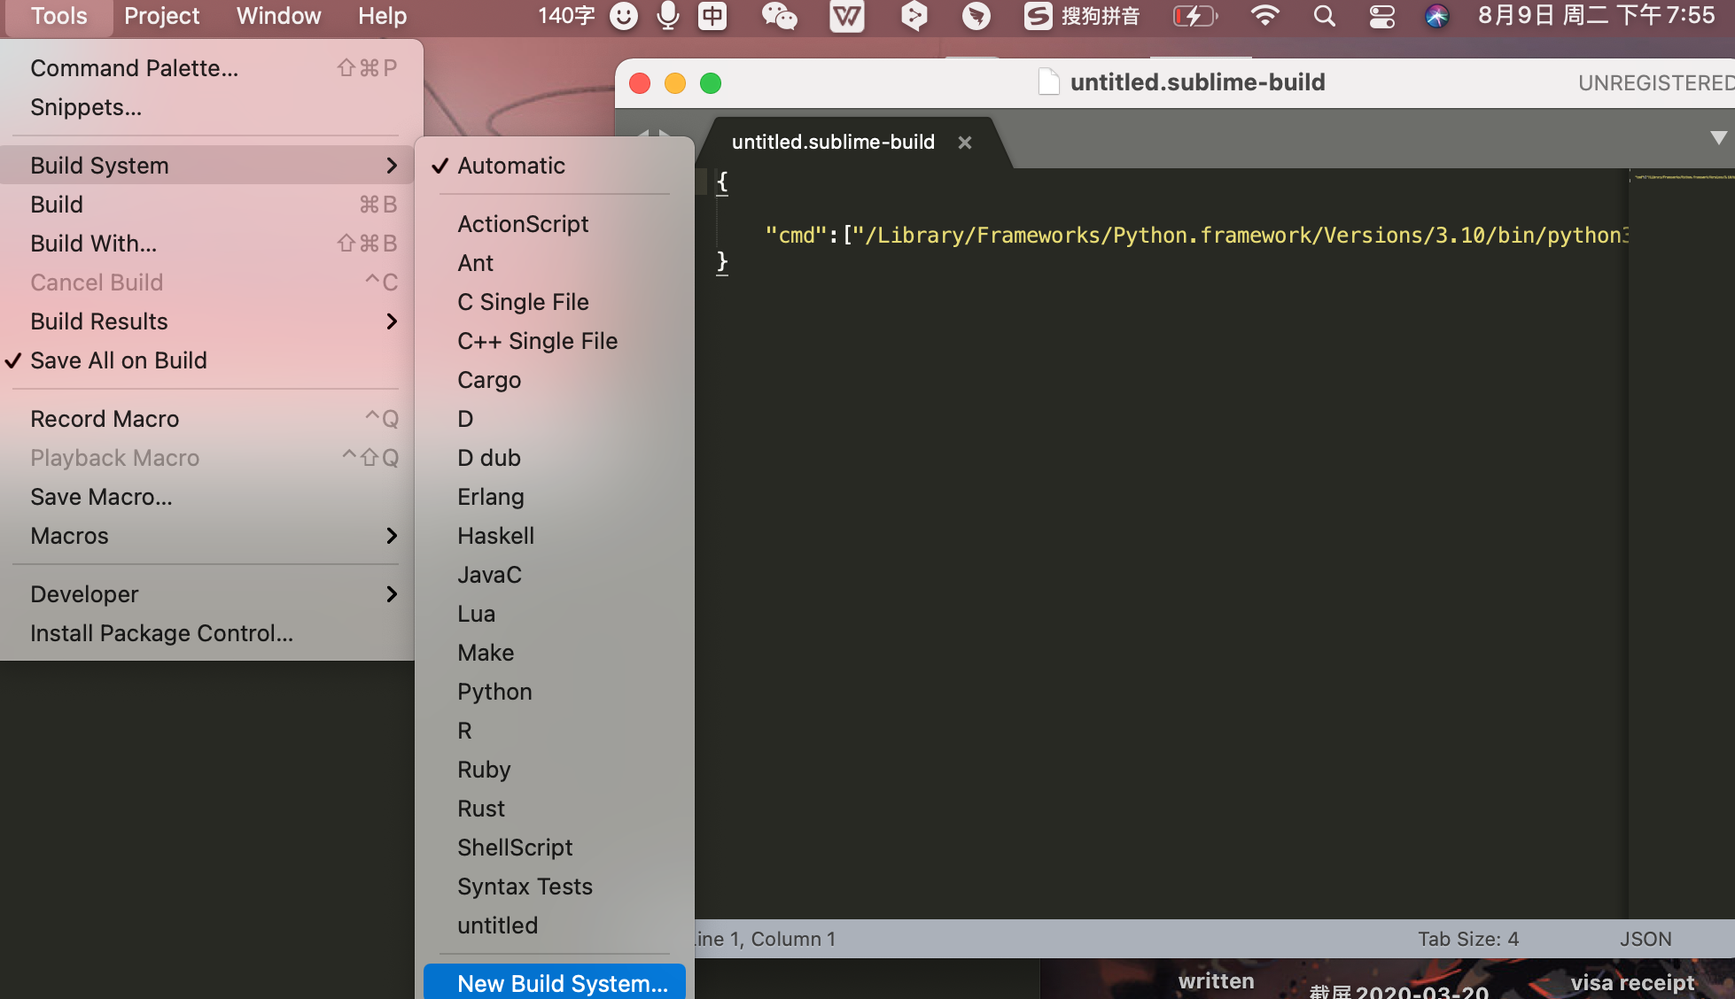
Mac

Slide 13
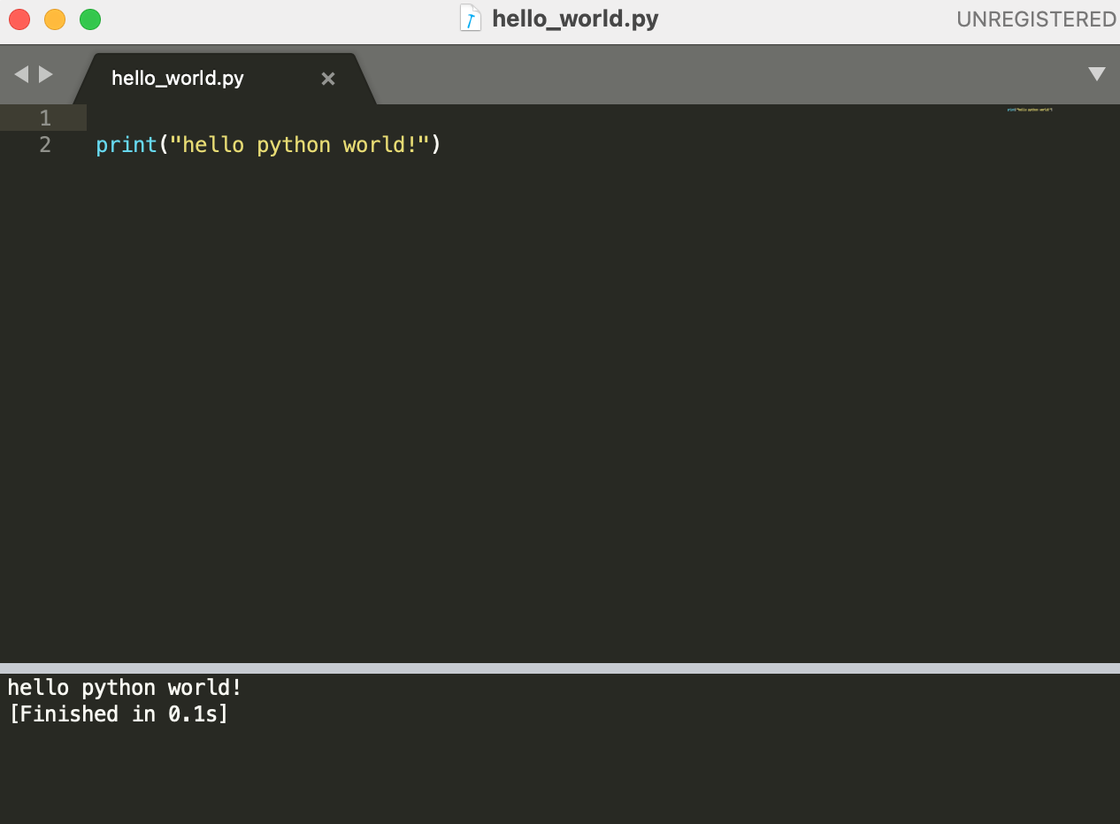
Mac

Slide 14
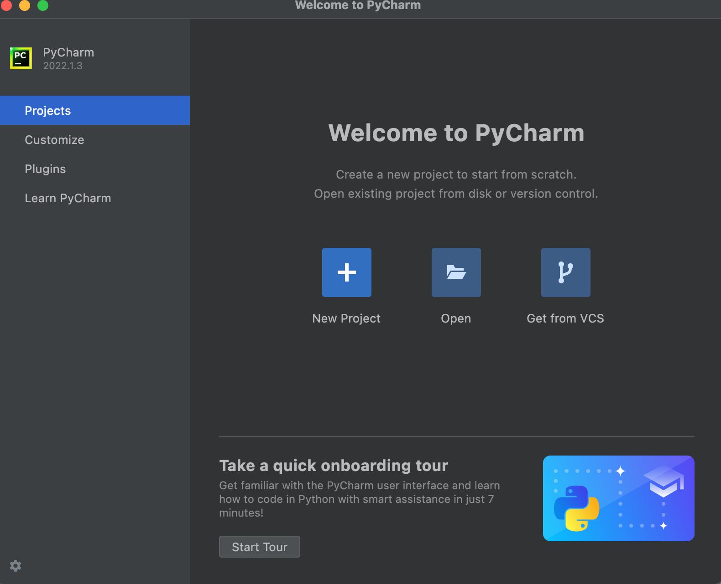
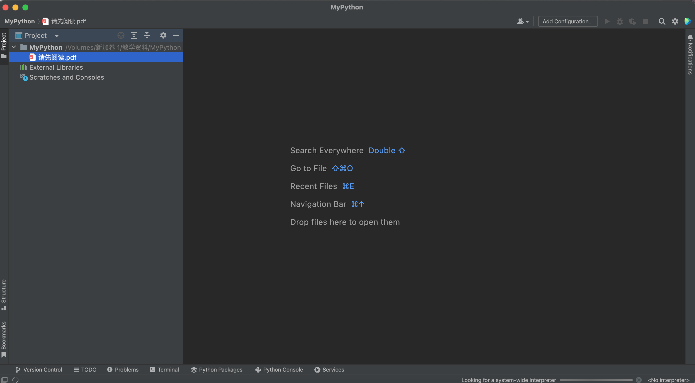
Mac

Slide 15
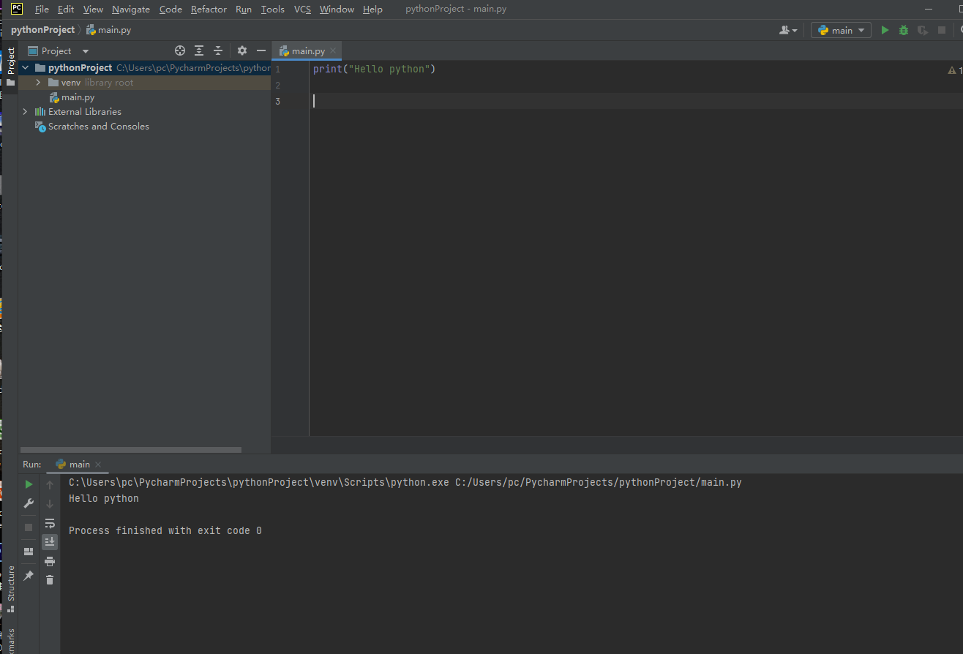
Mac

Slide 16
Goodbye

